Slide 1
Metropolitan Fire Chiefs Association Symposium The High Art of Refining Post-Cannabis Legalization Drug & Alcohol Policies
John E. Motylinski
Ottosen DiNolfo Hasenbalg & Castaldo, Ltd.

Slide 2
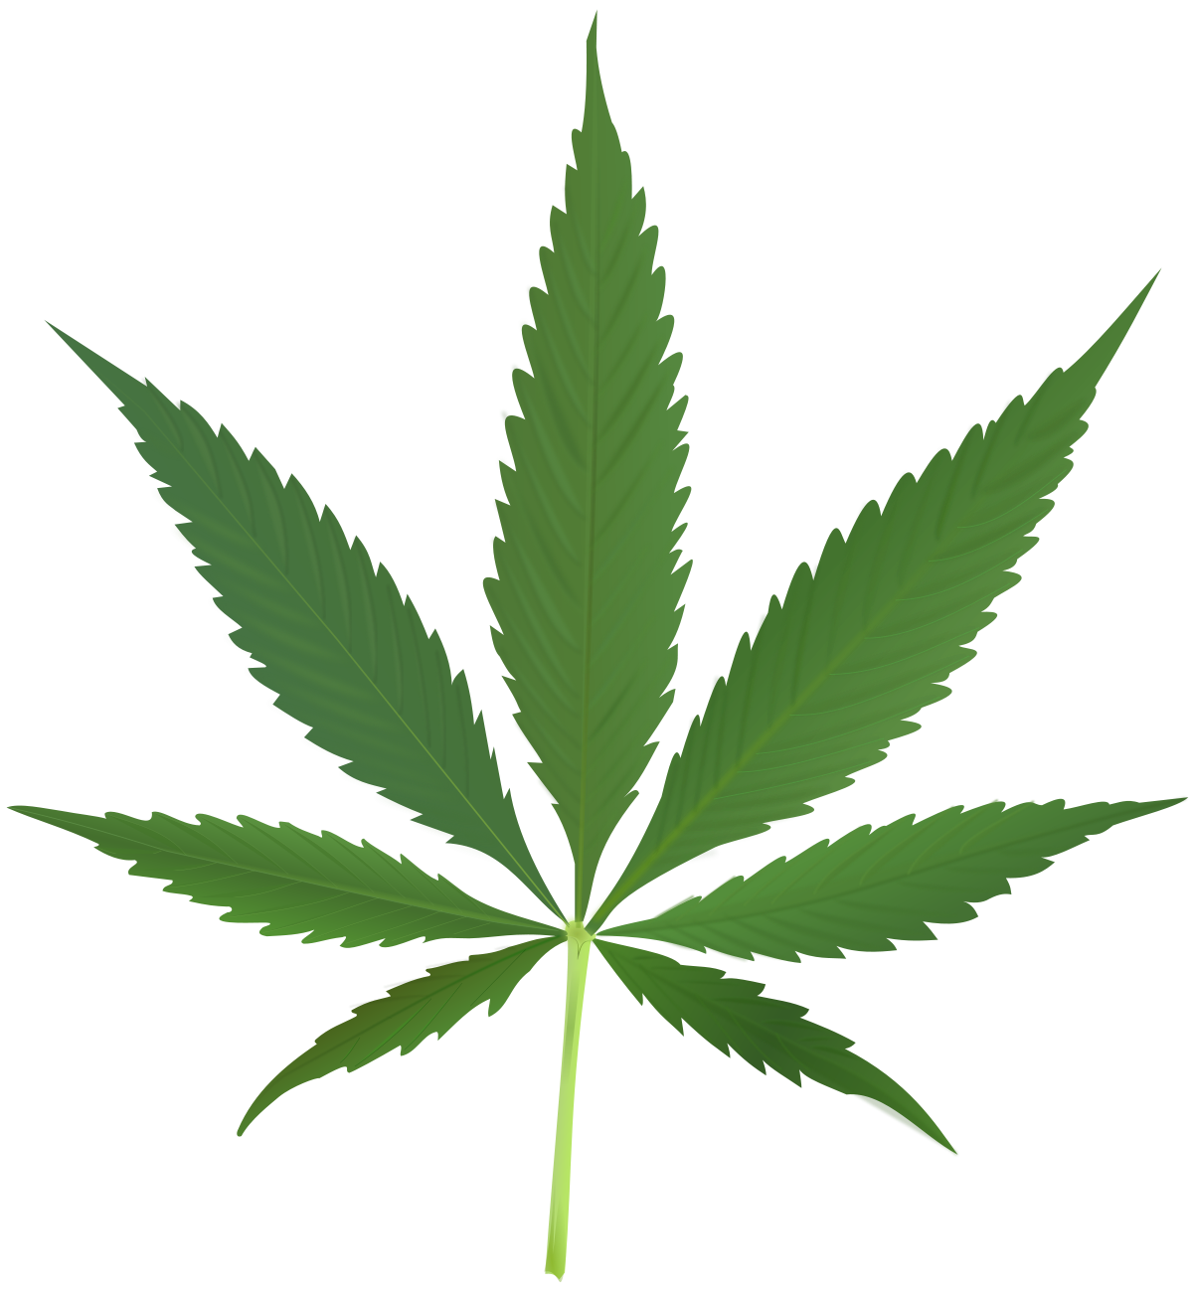
Topics Covered:
Background: Marijuana Generally
Medical Marijuana
The Cannabis Regulation and Tax Act
Employer Protections
Impact of Legalized Marijuana
Policies
Collective bargaining
Drug testing

Slide 3
Marijuana
Generally

Slide 4
Background: Marijuana
Marijuana is the dried flowers and leaves of the cannabis plant.
It contains mind-altering compounds like tetrahydrocannabinol (“THC”).
What causes people to feel “high.”
Also contains cannabidiol (“CBD”).
“Relaxing but not intoxicating.”
Not mind-altering, actually antagonistic to THC’s effects.
Routinely smoked or eaten.
Notes:
Active duty not defined, arguably includes those on paid time off.

Slide 5
Effects
Marijuana affects each person differently depending on their biology, the plant’s potency, previous experience with drugs, the way a person uses the drug, and the use of alcohol or other drugs at the same time.
Some feel nothing at all when they use marijuana.
Some feel relaxed or high.
Others suddenly get anxious and paranoid.
Especially when a person uses stronger marijuana, takes too much, or isn't used to taking it.

Slide 7
Short Term Negative Effects
Learning, attention, and memory problems.
Distorted perception (sights, sounds, time, touch).
Poor coordination.
Increased heart rate.
Anxiety.
Paranoia.
Psychosis (not common).
Notes:
Active duty not defined, arguably includes those on paid time off.

Slide 8
Middle Term Side Effects
Learning problems.
Memory problems.
Sleep problems.
Notes:
Active duty not defined, arguably includes those on paid time off.

Slide 9
Long Term Side Effects
Reported risk of marijuana addiction (controversial).
Long-term learning and memory problems if heavy use begins during youth.
Risk for chronic cough, bronchitis.
Risk of schizophrenia in some people with higher genetic risk.
In rare cases, risk of chronic nausea and vomiting.
Notes:
Active duty not defined, arguably includes those on paid time off.

Slide 10
Secondhand Effects
Depends on how much secondhand smoke is inhaled.
If you inhale secondhand marijuana smoke, it's unlikely you would fail a drug test (but it is possible).
But, increased chance of getting high if you are in an enclosed space with others smoking marijuana with high THC levels.
Secondhand marijuana smoke can affect heart and blood vessels as much as secondhand tobacco smoke.
Notes:
Active duty not defined, arguably includes those on paid time off.

Slide 11
Drug Testing
No substance test measures impairment (i.e., no “field sobriety” tests)
Types of Tests
Urine Tests
Tests for non-active THC, showing whether marijuana has been used
Blood tests
Tests for active THC, showing levels of compound
Saliva Tests
Tests for active THC, showing levels of compound, but only for the past 6-12 hours

Slide 12
Edibles
Why have this:
When you can have this?
Notes:
Active duty not defined, arguably includes those on paid time off.

Slide 13
Edibles
Edibles desired by individuals who do not want to smoke marijuana.
Edibles take longer to digest and longer to produce an effect.
People may consume more to feel the effects faster and harder.
Often last longer.
High doses yields:
Anxiety;
Paranoia; and
In rare cases, psychotic reactions (e.g., hallucinations, incoherent speech).
Notes:
Active duty not defined, arguably includes those on paid time off.

Slide 14
Legalization Efforts
Lawful in 11 States + DC
Alaska, California, Colorado, Illinois, Maine, Massachusetts, Michigan, Nevada, Oregon, Washington, Vermont
Decriminalized in 13 States (possession of small amounts results in civil offense)
Connecticut, Delaware, Maryland, Minnesota, Mississippi, Missouri, Nebraska, New York, New Hampshire, New Mexico, North Carolina, Ohio, Rhode Island
Misdemeanor in 12 States
Idaho, Indiana, Kansas, Kentucky, South Carolina, South Dakota, Tennessee, Utah, Virginia, West Virginia, Wisconsin, Wyoming
Only Medical in 11 States
Arizona, Arkansas, Florida, Hawaii, Louisiana, Montana, New Jersey, North Dakota, Oklahoma, Pennsylvania
Illinois: First marijuana legalization effort to pass via the legislative process.
Notes:
Active duty not defined, arguably includes those on paid time off.

Slide 15
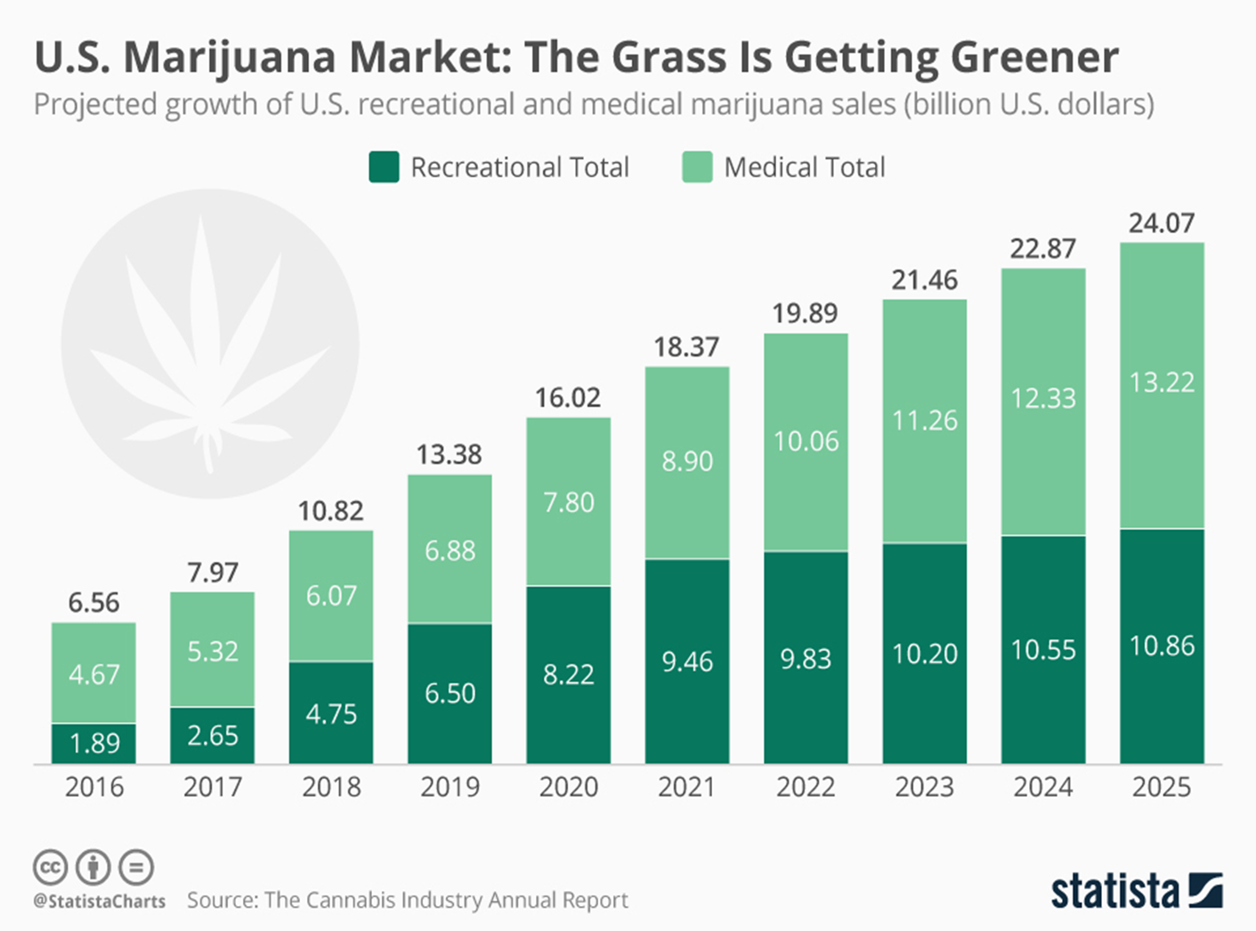
Cannabis:
A booming industry?

Slide 16
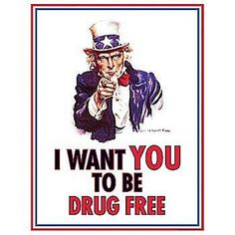
Federally Illegal
Marijuana is an illegal drug under Federal law (for now).
Notes:
Active duty not defined, arguably includes those on paid time off.

Slide 17
Medical Marijuana

Slide 18
Background: Medical Marijuana
Since 2014, marijuana has been legal for medicinal purposes in Illinois.
Need a doctor’s prescription.
Ordinarily, employers cannot refuse to employ an individual simply for using medical marijuana.
But, employers are not required to allow cannabis in the workplace.
Notes:
Active duty not defined, arguably includes those on paid time off.

Slide 19
Background: Medical Marijuana
Limited impact on the fire service:
“Active duty” firefighters or police officers cannot use it.
Also, anyone who performs their job while under the influence of medical marijuana could be subjected to malpractice / negligence lawsuits.
Notes:
Active duty not defined, arguably includes those on paid time off.

Slide 20
The Cannabis Regulation and Tax Act

Slide 21
The Cannabis Regulation and Tax Act
Enacted June 25, 2019, effective January 1, 2020.
Legalizes sale and possession of cannabis for recreational uses.
The Act places restrictions upon how much cannabis a person (21 years or older) may have in their possession at any given time”
Illinois residents: 30g of cannabis flower, 500mg of THC in cannabis infused product, or 5g cannabis concentrate.
Non-residents: 15g cannabis flower, 250mg of THC in cannabis infused product, or 2.5g cannabis concentrate.
Notes:
Active duty not defined, arguably includes those on paid time off.

Slide 22
The Cannabis Regulation and Tax Act
Only purchasable from licensed dispensaries.
Cash only businesses due to Federal restrictions with credit cards.
Recent robberies:
Chicago Tribune: Dispensary in Logan Square robbed of “more than $100,000 in cash.” (Jan. 10, 2020)
Chicago Sun Times: “Torch-wielding burglar stole $200k from pot shop’s safe, used key card to get inside.” (Jan. 21, 2020)
Notes:
Active duty not defined, arguably includes those on paid time off.

Slide 23
Expungements
Automatic Expungement:
Arrest records relating to offenses under the Cannabis Control Act for possession of under 30 grams of any substance containing cannabis that are not associated with an arrest, conviction, or other disposition of a violent crime.
Gubernatorial Expungement:
The Governor will grant pardons authorizing expungement for convictions for possession and manufacture or possession with intent to deliver for up to 30 grams.
Governor Pritzker pardoned 11,000 people with weed convictions on December 31, 2019.

Slide 24
Projected Revenue
Department of Revenue estimate:
The new cannabis industry will generate over $57 million in tax revenue and licensing fees in Fiscal Year 2020.
IDOR projects that the state will generate $140.5 million in tax revenue for Fiscal Year 2021
This does not include revenue from application and licensing fees.

Slide 25
Projected Revenue
Chicago Tribune: In the first twelve days of legalization, Illinois dispensaries sold more than $19.7 million.
Almost half a million transactions.
Sun Times: In January 2020, dispensaries sold nearly $40 million of legal weed.

Slide 26
What hasn’t changed?
It is still illegal to possess cannabis:
In a private vehicle, unless it’s “in a reasonably secured, sealed container and reasonably inaccessible while the vehicle is moving.”
Similar to alcohol open contained laws.
On school grounds and busses (except for qualifying medical use).
In licensed day care or social care facilities.
In any correctional facility.
Possession restrictions.

Slide 27
What hasn’t changed?
It is still illegal to use cannabis:
In any motor vehicle.
Anywhere close to anyone under 21 (unless they are receiving medical marijuana).
When smoked, in any place where smoking is otherwise prohibited under the Smoke Free Illinois Act (within 15 feet of any work entrance).
In any “public place.”
Defined as any place where a person could reasonably be expected to be observed by others,” including “all parts of buildings owned in whole or in part, or leased, by the State or a unit of local government.”
Consumption restrictions.

Slide 28
What hasn’t changed?
It is still illegal to use cannabis if you’re under 21.
Violation: Class A misdemeanor consistent with the Liquor Control Act of 1934 (i.e., up to 364 days jail time and/or up to $2,500 fine)
Secretary of State may suspend or revoke the driving privilege
It is still illegal to purchase marijuana for someone under 21.
Underage restrictions.

Slide 29
What hasn’t changed?
Prohibited advertisements are those:
That promote the overconsumption of cannabis.
That display cannabis.
That show someone under 21 consuming cannabis.
That make health or medicinal claims about cannabis.
That include the image of the cannabis leaf or bud.
That include any image that is likely to appeal to minors.
That are false or misleading.
Located on or in a public transportation vehicle or on a public transportation shelter.
Located within 1000 feet of school grounds, playgrounds, hospitals, health care facilities, recreation centers, child care centers, public parks, public libraries, or game arcades that admit persons under the age of 21.
Located on or in publicly owned or operated property.
Advertising restrictions.

Slide 30
What hasn’t changed?
Driving stoned is a criminal offense.
DUI Statute presumes impairment at 5 nanograms of THC in blood.
Driving While Intoxicated.

Slide 31
What hasn’t changed?
No workers’ compensation shall be payable if:
(1) an employee’s intoxication is the proximate cause of the accident, or
(2) the employee was so intoxicated at the time of the accident as to constitute a departure from his/her employment.
Just as with alcohol, if an employee is intoxicated/high on marijuana at the time of the accident, it is presumed the employee’s intoxication is the cause of the accident.
Workers’ Compensation.

Slide 32
What hasn’t changed?
Cannabis is still illegal under Federal law.
Compliance with Federal laws still required.
Drug Free Workplace Act:
Requires all federal grantees to agree they will provide drug-free workplaces as a precondition of receiving a contract or grant from a Federal agency.
Does not require drug testing.
Does not require an employer to fire an employee who tests positive.
CDL Requirements:
Independent drug testing requirements dictated by Federal regulation.
Testing positive on CDL drug test may result in loss of license.
Still banned by the Federal government.

Slide 33
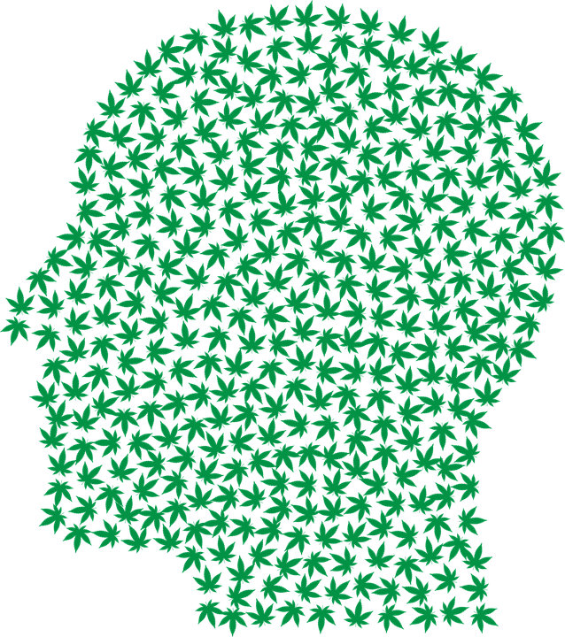
Employer Protections

Slide 34
Employer Protections
Cannabis Act Preamble: “Employee workplace safety shall not be diminished and employer workplace policies shall be interpreted broadly to protect employee safety.” 410 ILCS 705/1-5(e).
The Act has been reported to provide the most extensive workplace protections for employers of any marijuana legalization effort in the country.
Why?
Employers got a seat at the table during the Cannabis Act’s formulation.
Including employers who were worried about losing Federal funding.

Slide 35
Zero Tolerance Policies
Employers may adopt reasonable zero tolerance or drug free workplace policies
Employers may adopt employment policies concerning drug testing, smoking, consumption, storage, or use of cannabis in the workplace or while on call.
Must be applied in a nondiscriminatory manner.

Slide 36
Prohibiting On-Duty Impairment
Employers do not need to permit an employee to be under the influence of or use cannabis in the workplace.
An employer can discipline or terminate an employee for violating a valid drug policy.
There is lawsuit immunity for employers who generate a good faith belief that an employee is impaired by marijuana and then terminate them.

Slide 37
“Good Faith Belief”
A “good faith belief”:
If an employee manifests specific, articulable symptoms while working that decrease or lessen the employee's performance.
May include:
Symptoms of the employee's speech, physical dexterity, agility, coordination, demeanor, irrational or unusual behavior, or negligence or carelessness in operating equipment or machinery.
Disregard for the safety of the employee or others, or involvement in any accident that results in serious damage to equipment or property.

Slide 38
Federal Funding Priority
Employers do not have to do anything that would cause them to lose federal funding.
If a Federal grant depends on more onerous Federal requirements, then the Illinois law won’t stand in the way.

Slide 39
Public Safety-Specific Protections
Firefighters / police officers cannot use or be under the influence of cannabis while on duty or “on call.”
When an employee is scheduled with at least 24 hours' notice by his or her employer to be on standby.
Public safety employers can ban (1) off-duty use, (2) possession, (3) sale, (4) purchase, and (5) delivery of cannabis by firefighters / police officers.
Wasn’t always the case – new addition as of November 2019.
One qualification: Employees can’t be disciplined for the lawful possession / consumption of the employee’s family members.

Slide 40
The Right to Privacy in the Workplace Act
Unlawful for employers to refuse to hire, terminate, or treat an individual differently based on their use of lawful products during nonworking and non-call hours.
Example: Can’t refuse to hire an employee because she smokes tobacco at home.
Cannabis considered a “lawful product” under this Illinois law for non-public safety employees.
Does not apply to public safety personnel.
Fire departments can completely ban on and off-duty consumption of cannabis by firefighters.
Does apply to personnel who are not law enforcement officers, corrections officer, probation officer, or firefighters.
Fire departments cannot ban off-duty consumption of cannabis by administrative staff.
Staff must still show up to work unimpaired.

Slide 41
POLICY DECISIONS

Slide 42
Step 1: Determine What You Want to Do
Determine where you want to draw the line.
Range of restrictions:
Least
Firefighters are not allowed to use cannabis while on duty only.
Medium
Employees are not allowed to possess or use cannabis within 24 hours of a shift.
Most
Zero tolerance for using, possessing, selling, delivering, or purchasing cannabis at all times, on or off duty.

Slide 43
Step 2: Union or Non-Union?
Non-Union:
District can regulate cannabis however they want, as long as it is allowed by law and supported by good reasons.
Union:
Cannabis-related changes to a drug and alcohol policy are mandatory topics of bargaining.
Changes from status quo must be bargained.
Trailer Bill: Collective Bargaining Agreements on Cannabis are supreme.

Slide 44
Step 3: Where Does the Union Stand?
Bargaining units differ, there is no one-size-fits all approach.
Some:
Ban it all together, on and off duty. May advocate to no change to current policies in cases where marijuana still technically illegal.
Others:
Should only be allowed off-duty. Often agreeable to prohibiting consumption within 24 hours of one shift. Resistant to idea that District can regulate off-duty possession, delivery, sale, or purchase.
Still others:
Should be only allowed off-duty (only), no prohibitions on off-the-job use/sale/delivery/purchase.

Slide 45
What Are Unions Asking For?
IAFF Stock Proposal:
If an employee is suspected of being under the influence, they get sent to a doctor.
Doctor performs a blood test screening for cannabis.
A positive test is defined as ___ ng/ ml of THC.
Doctor examines all alternate medical explanations, employee’s medical history, other relevant biomedical factors.
Doctor opines on whether the individual was high at work.
No action can be taken without a finding that the employee was impaired by the doctor.
If there’s a negative finding, then test results/communications are destroyed.

Slide 46
What Are Unions Asking For?
The positive aspects:
This is not very different from how other drug tests are performed and handled.
Blood test presumptive positives can be set contractually.
Wouldn’t otherwise exist under the Cannabis Act.
The grievance procedure takes care of the requirement that an employee has a route to challenge an employer’s finding of impairment.

Slide 47
What You Should Insist On
A ban on use/possession of cannabis at work or while “on call.”
A ban on use/possession of cannabis within 24 hours of a shift (at least).
Subject to accommodation for non-emergency personnel.
A presumptive positive of 5 ng/ml of THC.
This tracks the state’s DUI threshold. If the firefighter can’t drive, they can’t come into work.
Mandatory on-duty drug exposure reporting
If an employee is exposed to cannabis while on-duty, they should be required to report it as with any other drug exposure.

Slide 48
What You Should Say “No” To:
A requirement that the District destroy public records.
This is illegal and unenforceable.
City of Chicago v. Fraternal Order of Police, 2019 IL App (1st) 172907 (destruction of disciplinary records provision held void due to strong public policy in keeping public records).
Local Records Act: Intentional destruction of local records is a class 4 felony.
A presumptive positive of 100 ng/ml of THC.
A real union proposal.

Slide 49
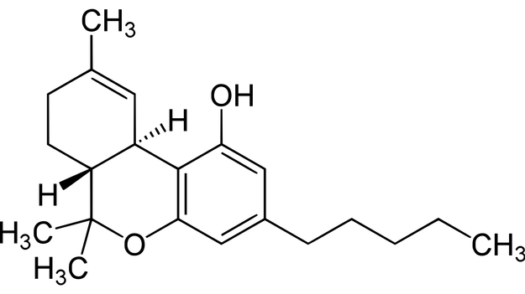
Pre- Employment Testing

Slide 50
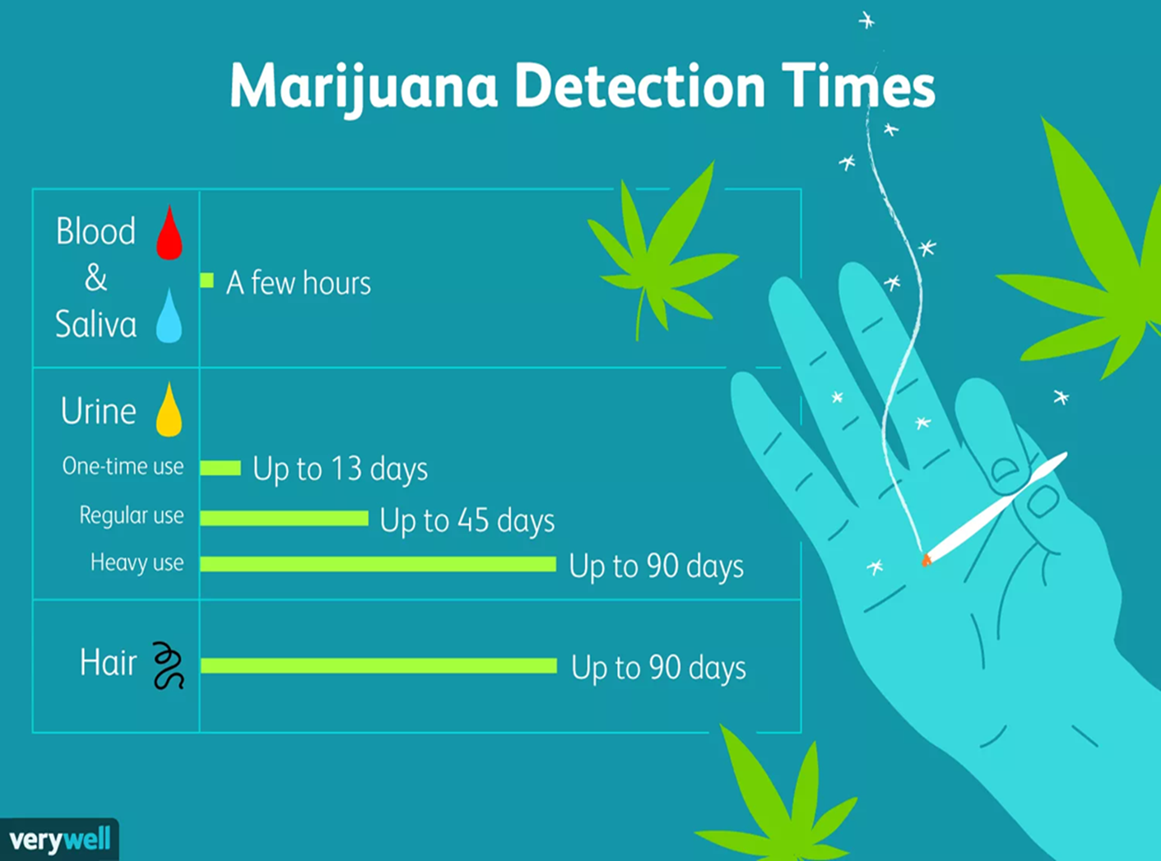
Pre-Hire Testing
Only shows previous usage.
Does not necessarily correspond to impairment or abuse

Slide 51
Pre-hire: To Test Or Not To Test
In general, the answer is do not test.
The hard question: why do you need to test for cannabis?
Banned on and off duty? Might seem to make sense to weed out candidates. However, it is testing for use of a legal substance.
Banned only on duty? Again, it is a legal substance. Positive result cannot be used to refuse to hire.
Thought experiment: would you test for alcohol?

Slide 52
To Test Or Not To Test
Discrimination lawsuits
Sometimes filed against employers on the basis that they declined to hire an individual because they were previously using lawfully prescribed medication.
No federal Americans with Disabilities problem, marijuana is still illegal under federal law.
Illinois Human Rights Act problem? Potentially.

Slide 53
Action Items

Slide 54
To-Do List:
Determine which approach the District wants to take for employee use/possession of cannabis.
Update employment policy manual and SOPs regarding drug use.
Consult with the Union as necessary.
Update CBA as necessary.
Revise pre-employment procedures as necessary.
Inform employees/train officers regarding changes and reasonable suspicion standard.

Slide 55
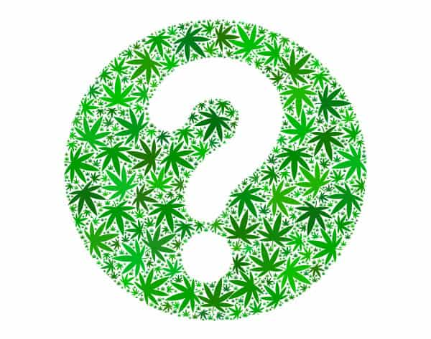
QUESTIONS?

