Slide 1
THE NEW PENSION CONSOLIDATION LAW & its IMPACT ON ARTICLE 4 firefighter PENSION FUNDS

Slide 2
HOW DID WE GET HERE? A BRIEF HISTORY

Slide 3
BRIEF History of pension consolidation
This is not a new idea.
Pension consolidation has been discussed in Springfield for over seventy years.
Three important police and firemen’s pension bills appeared defeated today but efforts may be made to revive one which would consolidated 335 pension systems outside of the City of Chicago . . .”
May 26, 1965 Chicago Tribune news article

Slide 4
BRIEF History of pension consolidation
This same article considered the City of Chicago’s funding status as being “in good shape” when the City was only 35% funded.
Cite: Forbes, Jan. 4, 2020 by Elizabeth Bauer
P.A. 101-0610 was based in large part from the findings of the Illinois Pension Consolidation Feasibility Task Force, which issued a 22 page report on October 10, 2019.

Slide 5
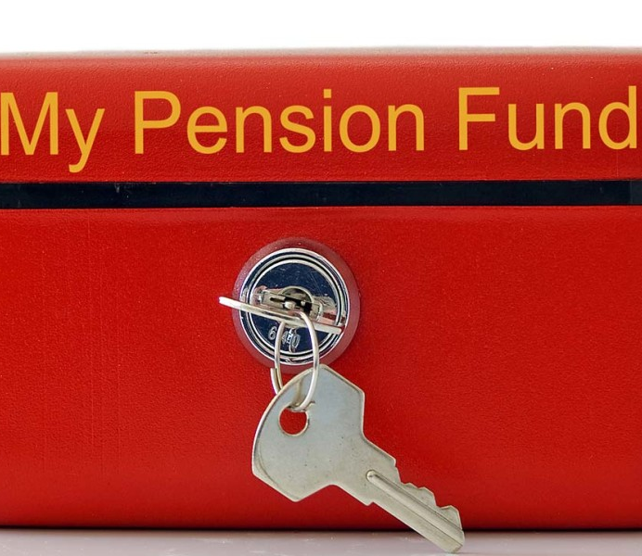
Key provisions impacting operations of article 4 funds

Slide 6
definitions
“Transferor Pension Fund”
Any Article 3 or 4 pension fund.
“Fund” or “Consolidated Fund”
Newly Created Firefighters’ Pension Investment Fund (FPIF)
“Participating Pension Fund”
An Article 4 pension fund that has transferred its assets to the Consolidated Fund

Slide 7
definitions
“Transition Period”
Period during which pension fund assets, and the responsibility for custody and control of those assets, will be transferred from the transferor pension funds to the Consolidated Pension Fund Board (FPIF).
The transition period has already commenced as of January 1, 2020 and will extend through July 1, 2022.

Slide 8
Transfer of pension assets
Upon the transfer of its pension assets to the FPIF, the transferor fund shall no longer exercise any investment authority or fiduciary responsibility over those pension assets.
The FPIF has a 30-month period to transition the assets, no later than July 1, 2022.

Slide 9
Transfer of actuarial responsibility
At the end of the transition period, the FPIF shall prepare an actuarial report for each local fund.
The actuarial required contribution shall be submitted annually by FPIF to employers.
Any assumption changes phased in over 3 years.

Slide 10
Areas of legislative silence
To what extent will the FPIF change the current actuarial assumption in place for Article 3 and 4 funds?
What happens to employers who are unable or unwilling to levy the funds as set forth by the FPIF actuarial report? (IMRF Model?)

Slide 11
Remaining responsibilities
P.A. 101-0610 does not eliminate Article 4 funds. Article 4 funds remain responsible for other duties, including the “exclusive authority” to adjudicate and award:
Disability benefits,
Retirement benefits,
Survivor benefits, and
To issue refunds.
The FPIF has no authority to control, alter, or modify, or the ability to review or intervene in, the proceedings or decisions of the pension board in determining such benefits.

Slide 12
You may maintain A local bank account
After the end of the transition period, Article 4 funds may continue to maintain an interest-bearing account for purposes of benefit payments and other reasonable expenses.
Funds are encouraged to use a local bank / financial institution to fill this need.
This Photo by Unknown Author is licensed under CC BY-NC-ND

Slide 13
Another regulator to serve
After the conclusion of the transition period, the DOI may accept and rely upon the annual audits prepared by CPAs hired by FPIF.
FPIF and DOI are both empowered to examine and investigate Article 4 funds

Slide 14
fee hike for most funds?
After the conclusion of the transition period, the annual compliance fee shall be a flat $8,000 per fund per year.
Was 2bps, capped at $8k
All fees shall thereafter be paid by the FPIF.
Question about language interpretation remain.
This Photo by Unknown Author is licensed under CC BY-SA

Slide 15
Relief FROM training hours
Initial training requirements for new pension trustees is now 16 hours, instead of 32 hours.
Annual ongoing training requirements for pension trustees is now 8 hours, instead of 16 hours.
ALL current trustees are required to participate in a mandatory 4-hour training session on the changes made by this Public Act.
Article 4 trustees may have their training conducted by “a fund” or the Department of Insurance.

Slide 16
Relief FROM training hours
Training components are now:
Fiduciary duties and liabilities with respect to the administration and payment of pension benefits (formerly, Article 1 responsibilities more broadly).
Adjudication of pension claims.
Trustee ethics.
Illinois Open Meetings Act.
Illinois Freedom of Information Act.

Slide 17
Enhanced benefits for Tier II Firefighters

Slide 18
Changes - tier ii CALCULATION
ALTERS THE FINAL AVERAGE SALARY CALCULATION
CHANGE TO SALARY CAP
FOR PENSIONABLE SALARY
NOW the greater of (i) the average monthly salary obtained by dividing the total salary of the police officer or firefighter during the 48 (was 96) consecutive months of service within the last 60 (was 120) months of service in which the total salary was the highest by the number of months of service in that period; or (2) the average monthly salary obtained by dividing the total salary of the police officer or firefighter during the 96 consecutive months of service within the last 120 months of service in which the total salary was the highest by the number of months of service in that period.
NOW annually increased by the lesser of (1) 3% of that amount, including all previous adjustments, or (2) the annual unadjusted percentage increase (previously, one half) (but not less than zero) in the consumer price index-urban for the 12 months ending with the September preceding each November 1, including all previous adjustments.

Slide 19
SURVIVOR PENSION CORRECTIVE LANGUAGE
Survivors of Tier II members shall be entitled to a benefit in an amount that is equal to the greater of (new) (1) 54% of the firefighter’s monthly salary at the date of death (new), or (2) 66 2/3% of the firefighter’s earned pension at the date of death.
If there is a surviving spouse, 12% of monthly salary shall be granted to the guardian of any minor children until age 18. Upon death of surviving spouse leaving minor children, or upon death of firefighter leaving minor children by no surviving spouse, 20% of monthly salary shall be granted to the guardian of each such child until age 18. Total pension provided shall not exceed 75% of the monthly salary of the deceased firefighter under most circumstances.
PARITY with Tier I—retroactive application.

Slide 20
What Powers are Granted to the New Board

Slide 21
TWO boards are created
TRANSITION BOARD
PERMANENT BOARD
Nine-member board appointed by the Governor.
Split among municipal, labor, and active participants & beneficiaries.
Only serve until the Permanent Board members are elected and qualified.
Responsible for administering the elections for permanent board. Must occur no later than January 1, 2021.
Nine-member board elected among specified subsets of membership groups.
Split among municipal, labor, active participants & beneficiaries.
Initial board will serve staggered terms of either two or four years in length.
Vacancies filled in same manner for unexpired terms.

Slide 22
fpif BOARD MEMBER REQUIREMENTS
Oath of office taken before the IL Secretary of State
Must be bonded
No conflicts of interest
No salary, but may be reimbursed for travel
Active firefighter members must be provided paid time off by employers

Slide 23
TRANSITION BOARD DUTIES
Select a Chairperson who will serve for the duration of the transition period.
Must appoint an interim Executive Director no later than 2 months after the transition board is appointed.
+/- March 31, 2020
As soon as practicable, the board and DOI shall jointly audit the investment assets of each local fund to determine a certified asset list for each fund using a CPA firm engaged by the board.

Slide 24
TRANSITION BOARD DUTIES
Adopt the first annual budget.
May hire external legal counsel and independent auditing firm as well as investment professionals “as may be desirable” to assist in transition.
May borrow money from Illinois Finance Authority as needed (capped at $7.5M).
Shall adopt rules to implement the transition process including transfer of assets to the FPIF, assumption of fiduciary control and termination of previous fiduciary and custodial relationships.

Slide 25
Administrative RULEMAKING by the FPIF
The FPIF shall adopt rules that address, among other things:
*Implementation of the transition process from local fund to FPIF
*Process by which local funds may request fund transfers
*Process by which municipal contributions may be transferred from local fund to the FPIF
*Process to account for pension assets received by FPIF after transition period.

Slide 26
TRANSITION BOARD
Transition Board for the FPIF had its first meeting on January 31st.
The Transition Board:
Received draft bylaws
Are taking nominations for the executive director and legal counsel positions.
Reviewed a draft budget and draft employee directive manual.
The Transition Board has its next meeting on February 12, 2020 at 1 pm with additional meetings planned for February 20th and 28th at 9 am.

Slide 27
PERMANENT BOARD DUTIES
Rotating Chairperson every two years (Municipal / Participant)
Must appoint a permanent Executive Director no later than 6 months after the end of the transition period.
+/- January 1, 2023
May appoint investment consultants, custodians, and other professional services as deemed prudent to implement the transition of assets. Not bound by contracts of transition board.

Slide 28
PERMANENT BOARD DUTIES
Board must act prudently and as fiduciaries.
Board shall take “all reasonable steps to ensure that all of the transferor pension funds are treated equitably” and that the financial condition of one Art 4 fund has no impact on the financial condition of any other Art 4 fund.
FPIF fiscal year begins July 1, ends June 30th
Unknown: will all Article 4 funds be required to switch to same fiscal year?

Slide 29
PERMANENT BOARD VOTING
Board shall meet at least quarterly.
Voting has been established as follows:
Quorum of 6 members
5 votes to pass most votes.
BUT, Supermajority of 6 votes required for:
Adoption of actuarial assumptions;
Selection of chief investment officer, consultant, or fiduciary counsel;
Adoption of investment or asset allocation policies;
Adoption of trustee election rules.

Slide 30
Overseeing the asset transfer
FPIF will provide 30 days’ written notice to local fund as to when the transfer will take effect; Local fund must inform custodian and managers.
CPA hired by FPIF will audit and generate a certified investment asset list.
Once asset list is complete, local fund will be directed by FPIF not to buy or sell any assets.

Slide 31
Overseeing the asset transfer
On the designated transfer day, assets will be transferred, presumedly in kind, from the local fund to the FPIF.
Local fund no longer has any investment authority and FPIF incurs all statutory and fiduciary responsibility for the management of pension assets.
Local fund will receive a written receipt for assets.

Slide 32
FULL INVESTMENT AUTHORITY
FPIF shall have full authority to invest funds, subject to restrictions of Art. 1 of the Illinois Pension Code.
All assets are invested in the name of the FPIF.
All investments shall be placed with a bonded custodian selected by the FPIF.
This Photo by Unknown Author is licensed under CC BY-NC-ND

Slide 33
More investment DETAILS
FPIF shall not be limited by the investment restrictions in the same manner as Article 3 and 4 funds.
FPIF may directly invest assets in public market investments, private investments, real estate investments, or other investments permitted in Article 1 of the Pension Code.
All assets must be held in accounts outside of the State treasury.

Slide 34
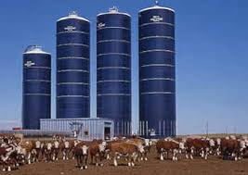
Use of separate accounts
FPIF is required by law to separately calculate account balances for each Art 4 fund.
Operations and financial condition of one fund shall not affect the account balance of any other pension fund.
Investment returns shall be allocated and distributed pro rata in accordance with the assets held by each fund.

Slide 35
The FPIF must be annually audited by CPA using GASB standards.
The FPIF must provide quarterly and annual investment reports to all Article 4 funds that show returns, gains, losses and administrative costs.
The fiscal year starts July 1st and ends June 30th.
REPORTING REQUIREMENTS

Slide 36
questions?
Meganne Trela
Ottosen DiNolfo
Hasenbalg & Castaldo, Ltd.
1804 N. Naper Blvd.
Suite 350
Naperville, IL. 60563
630-682-0085

